Slide 1

Chapter 7
Transmission Media
Copyright © The McGraw-Hill Companies, Inc. Permission required for reproduction or display.
Notes:
‹#›

Slide 2
Chapter 7: Outline
7.1 INTRODUCTION
7.2 GUIDED MEDIA
7.3 UNGUIDED MEDIA
Notes:
7.#

Slide 3

Chapter 7: Objective
The first section introduces the transmission media and defines its position in the Internet model. It shows that we can classify transmission media into two broad categories: guided and unguided media.
The second section discusses guided media. The first part describes twisted-pair cables and their characteristics and applications. The second part describes coaxial cables and their characteristics and applications.
The third section discusses unguided media. The first part describes radio waves and their characteristics and applications. The second part describes microwaves and their characteristics and applications.
Notes:
7.#

Slide 4
7-1 INTRODUCTION
Transmission media are actually located below the physical layer and are directly controlled by the physical layer. We could say that transmission media belong to layer zero. Figure 7.1 shows the position of transmission media in relation to the physical layer.
7.‹#›
Notes:
7.#

Slide 5

Figure 7.1: Transmission media and physical layer
7.‹#›
Notes:
7.#

Slide 6
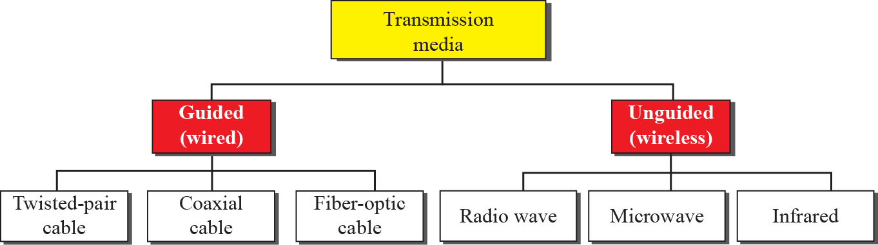
Figure 7.2: Classes of transmission media
7.‹#›
Notes:
7.#

Slide 7
7-2 GUIDED MEDIA
Guided media, which are those that provide a conduit from one device to another, include twisted-pair cable, coaxial cable, and fiber-optic cable. A signal traveling along any of these media is directed and contained by the physical limits of the medium.
7.‹#›
Notes:
7.#

Slide 8
7.2.1 Twisted-Pair Cable
A twisted pair consists of two conductors (normally copper), each with its own plastic insulation, twisted together, as shown in Figure 7.3.
One of the wires is used to carry signals to the receiver, and the other is used only as a ground reference. The receiver uses the difference between the two.
In addition to the signal sent by the sender on one of the wires, interference (noise) and crosstalk may affect both wires and create unwanted signals.
7.‹#›
Notes:
7.#

Slide 9

Figure 7.3: Twisted-pair cable
7.‹#›
Notes:
7.#

Slide 10
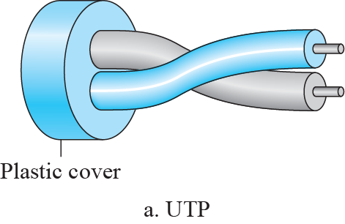
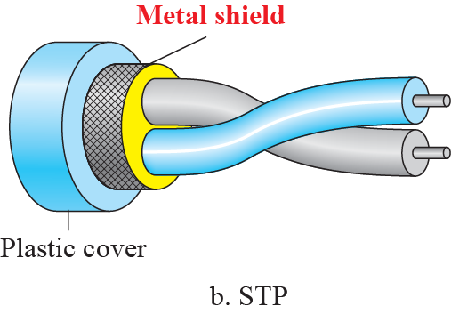
Figure 7.4: UTP and STP cables
7.‹#›
Notes:
7.#

Slide 11
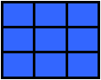
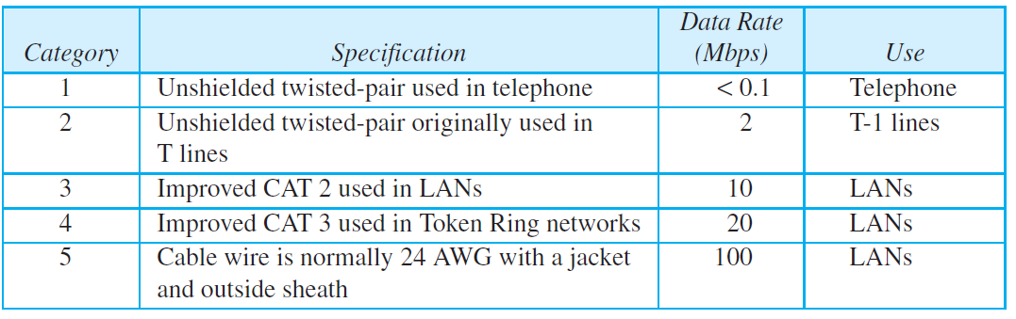
Table 7.1: Categories of unshielded twisted-pair cables
7.‹#›
Notes:
‹#›

Slide 12
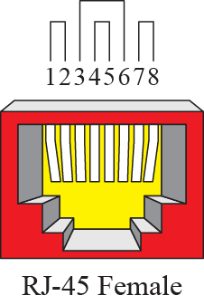
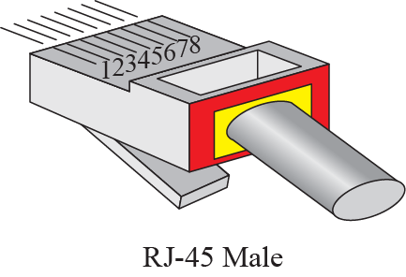
Figure 7.5: UTP Connectors
7.‹#›
Notes:
7.#

Slide 13
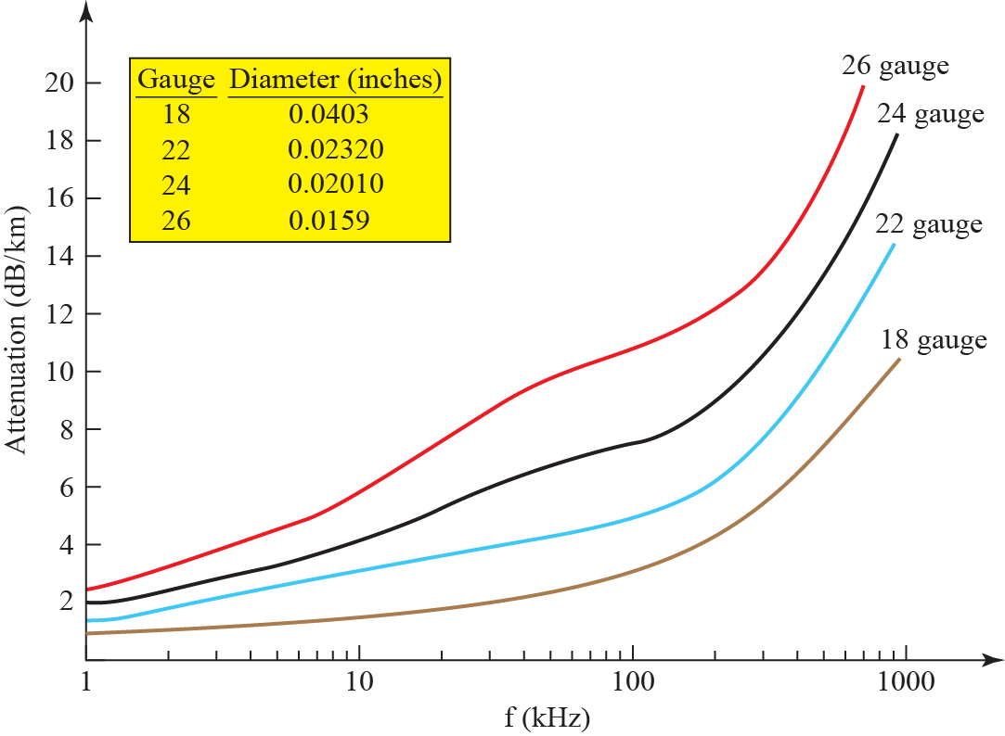
Figure 7.6: UTP Performance
7.‹#›
Notes:
7.#

Slide 14
7.2.2 Coaxial Cable
Coaxial cable (or coax) carries signals of higher frequency ranges than those in twisted pair cable, in part because the two media are constructed quite differently. Instead of having two wires, coax has a central core conductor of solid or stranded wire (usually copper) enclosed in an insulating sheath, which is, in turn, encased in an outer conductor of metal foil, braid, or a combination of the two. The outer metallic wrapping serves both as a shield against noise and as the second conductor, which completes the circuit.
7.‹#›
Notes:
7.#

Slide 15
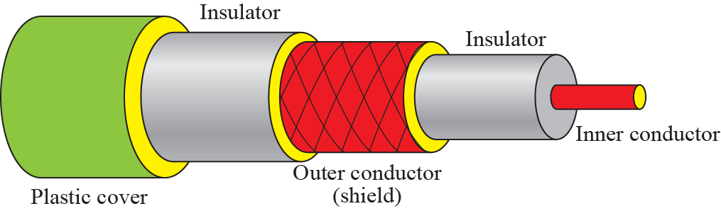
Figure 7.7: Coaxial cable
7.‹#›
Notes:
7.#

Slide 16
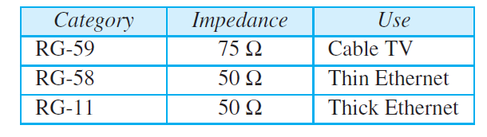
Table 7.2: Categories of coaxial cables
7.‹#›
Notes:
‹#›

Slide 17
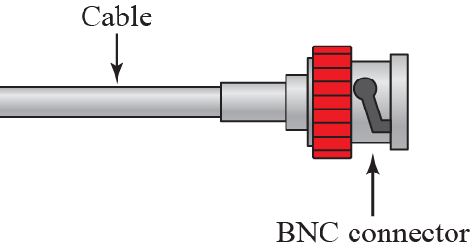
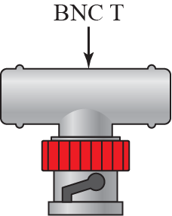
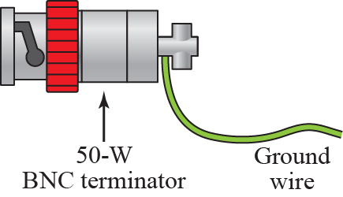
Figure 7.8: BNC connectors
7.‹#›
Notes:
7.#

Slide 18
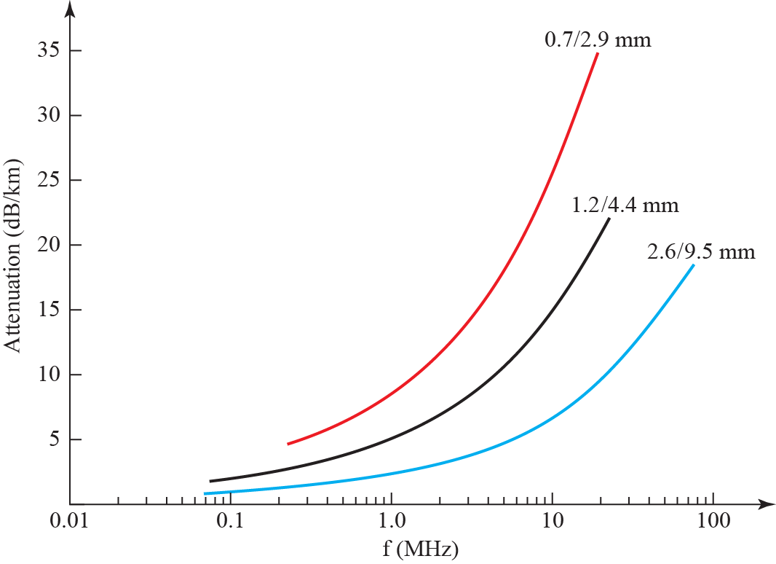
Figure 7.9: Coaxial cable performance
7.‹#›
Notes:
7.#

Slide 19
7.2.3 Fiber-Optic Cable
A fiber-optic cable is made of glass or plastic and transmits signals in the form of light. To understand optical fiber, we first need to explore several aspects of the nature of light.
Light travels in a straight line as long as it is moving through a single uniform substance. If a ray of light traveling through one substance suddenly enters another substance (of a different density), the ray changes direction. Figure 7.10 shows how a ray of light changes direction when going from a more dense to a less dense substance.
7.‹#›
Notes:
7.#

Slide 20
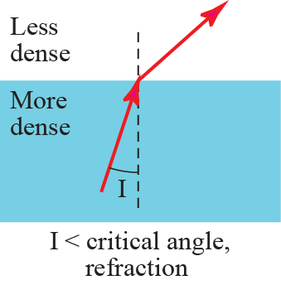
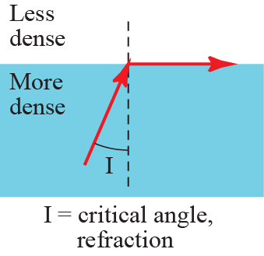
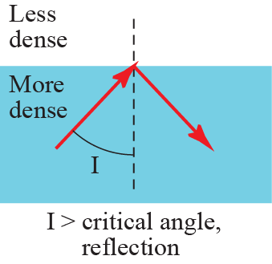
Figure 7.10: Bending of light ray
7.‹#›
Notes:
7.#

Slide 21
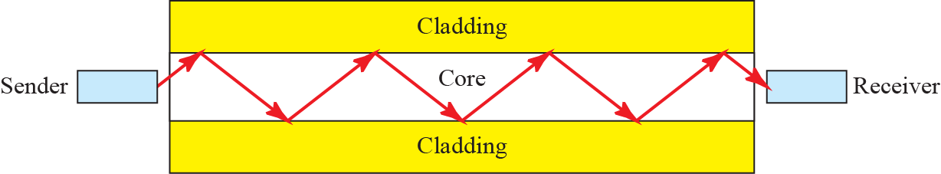
Figure 7.11: Optical fiber
7.‹#›
Notes:
7.#

Slide 22
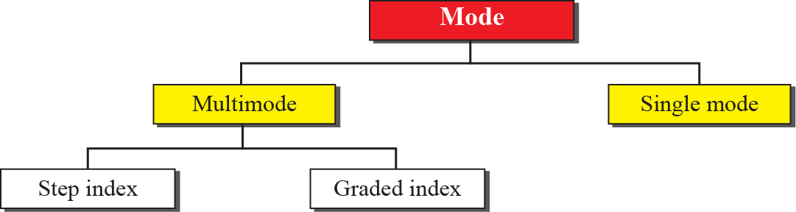
Figure 7.12: Propagation modes
7.‹#›
Notes:
7.#

Slide 23

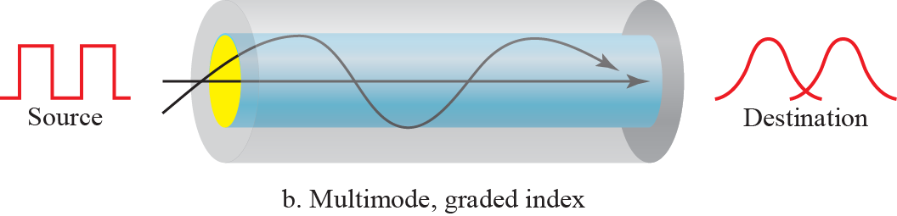

Figure 7.13: Modes
7.‹#›
Notes:
7.#

Slide 24
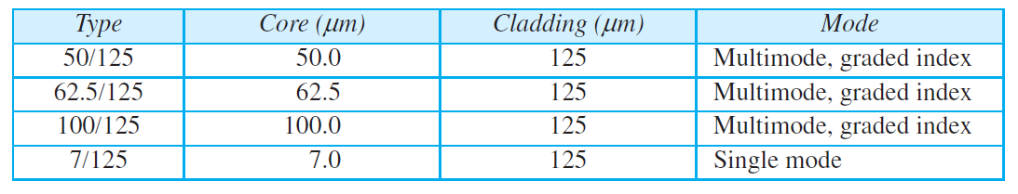
Table 7.3: Fiber types
7.‹#›
Notes:
‹#›

Slide 25
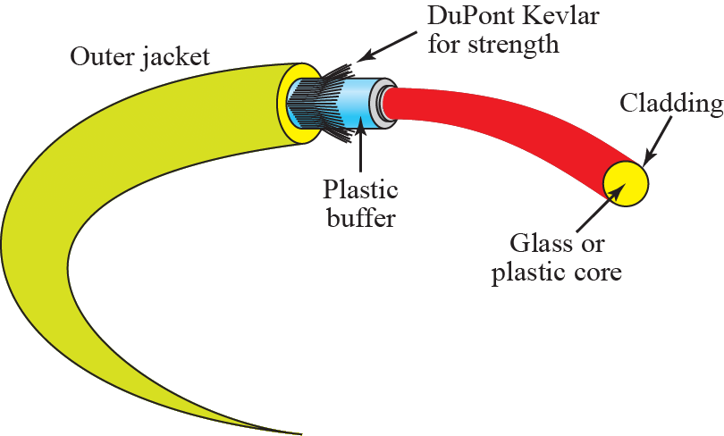
Figure 7.14: Fiber connection
7.‹#›
Notes:
7.#

Slide 26
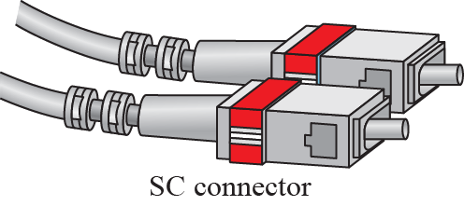
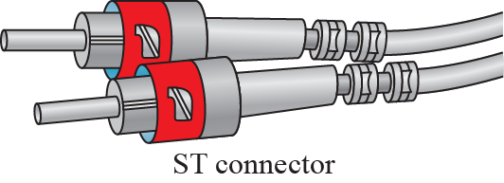
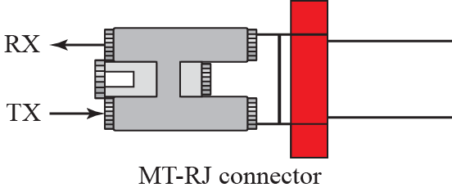
Figure 7.15: Fiber-optic cable connector
7.‹#›
Notes:
7.#

Slide 27
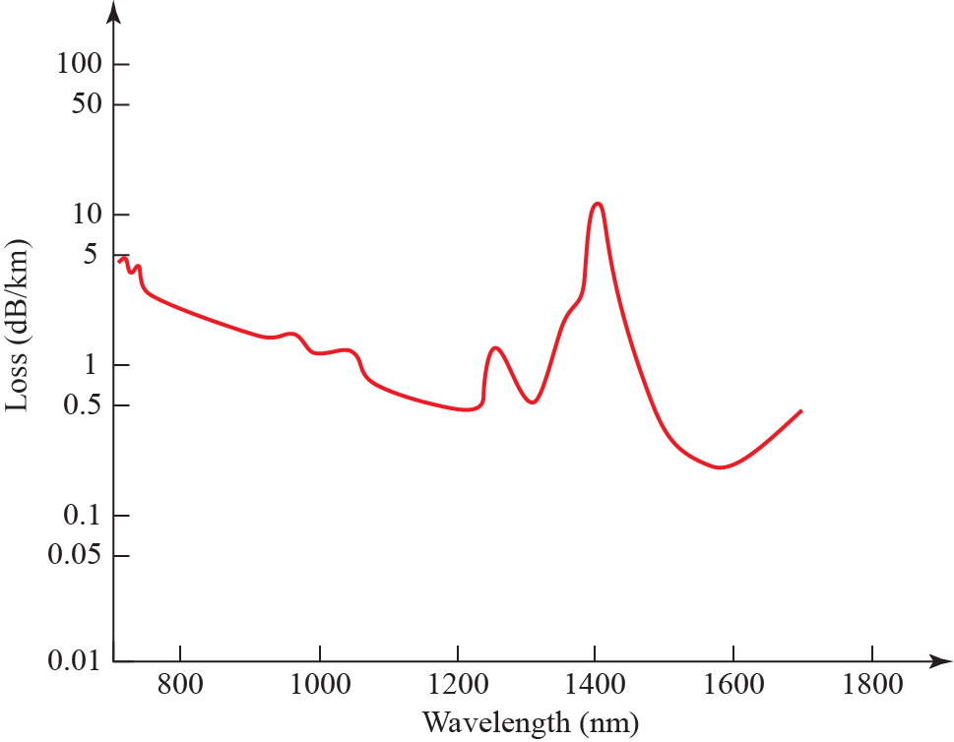
Figure 7.16: Optical fiber performance
7.‹#›
Notes:
7.#

Slide 28
7-3 UNGUIDED MEDIA
Unguided medium transport waves without using a physical conductor. This type of communication is often referred to as wireless communication. Signals are normally broadcast through free space and thus are available to anyone who has a device capable of receiving them.
7.‹#›
Notes:
7.#

Slide 29
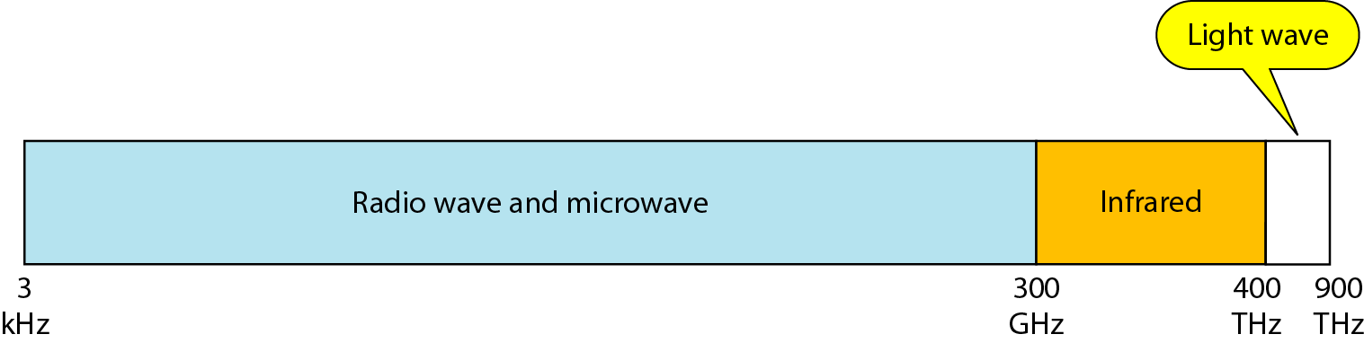
Figure 7.17: Electromagnetic spectrum for wireless communication
7.‹#›
Notes:
7.#

Slide 30
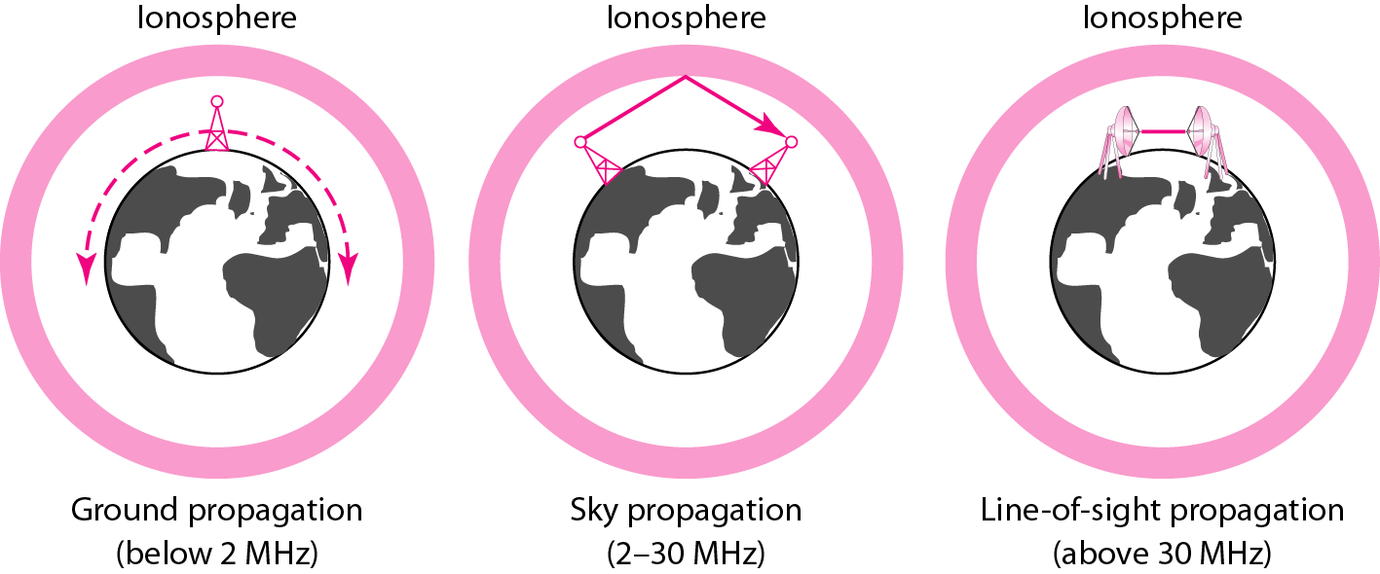
Figure 7.18: Propagation methods
7.‹#›
Notes:
7.#

Slide 31
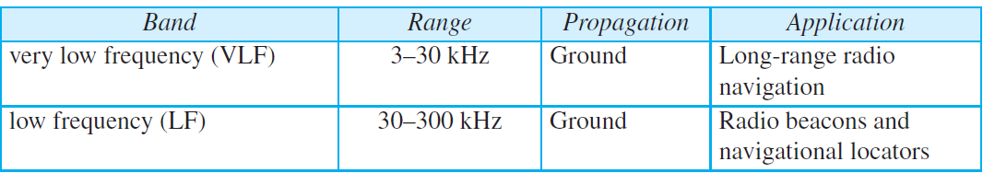
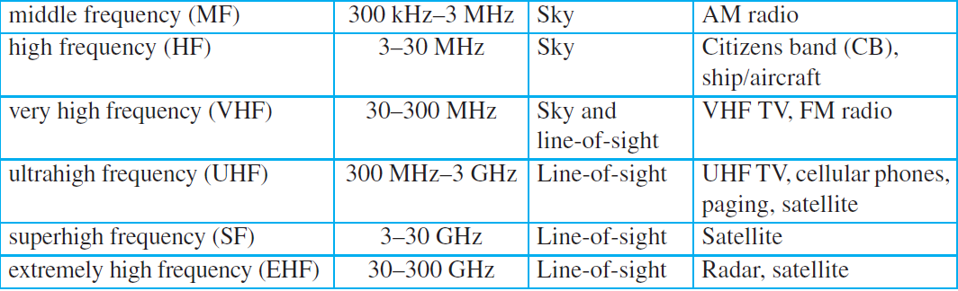
Table 7.4: Bands
7.‹#›
Notes:
‹#›

Slide 32
7.3.1 Radio Waves
Although there is no clear-cut demarcation between radio waves and microwaves, electromagnetic waves ranging in frequencies between 3 kHz and 1 GHz are normally called radio waves; waves ranging in frequencies between 1 and 300 GHz are called microwaves. However, the behavior of the waves, rather than the frequencies, is a better criterion for classification.
7.‹#›
Notes:
7.#

Slide 33
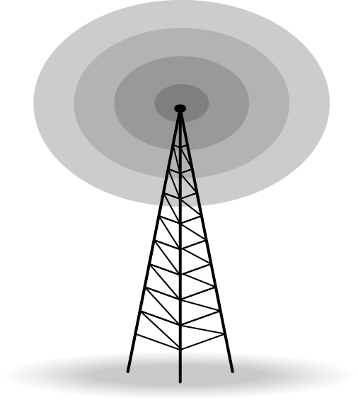
Figure 7.19: Omnidirectional antenna
7.‹#›
Notes:
7.#

Slide 34
7.3.2 Microwaves
Electromagnetic waves having frequencies between 1 and 300 GHz are called microwaves. Microwaves are unidirectional. When an antenna transmits microwaves, they can be narrowly focused. This means that the sending and receiving antennas need to be aligned. The unidirectional property has an obvious advantage. A pair of antennas can be aligned without interfering with another pair of aligned antennas.
7.‹#›
Notes:
7.#

Slide 35
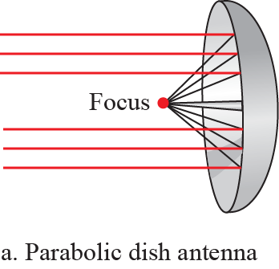
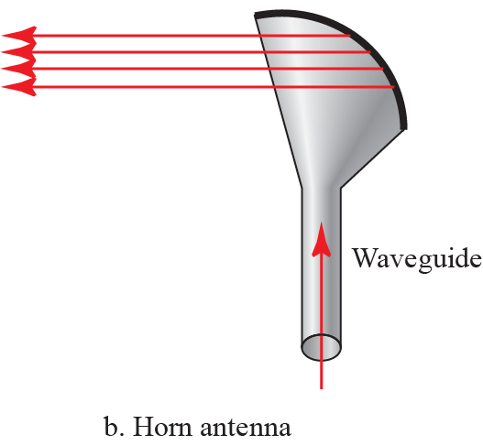
Figure 7.20: Unidirectional antenna
7.‹#›
Notes:
7.#

Slide 36
7.3.3 Infrared
Infrared waves, with frequencies from 300 GHz to 400 THz (wavelengths from 1 mm to 770 nm), can be used for short-range communication. Infrared waves, having high frequencies, cannot penetrate walls. This advantageous characteristic prevents interference between one system and another; a short-range communication system in one room cannot be affected by another system in the next room. When we use our infrared remote control, we do not interfere with the use of the remote by our neighbors.
7.‹#›
Notes:
7.#

